Slide 1
Programme Presentation
November 2019

Slide 2
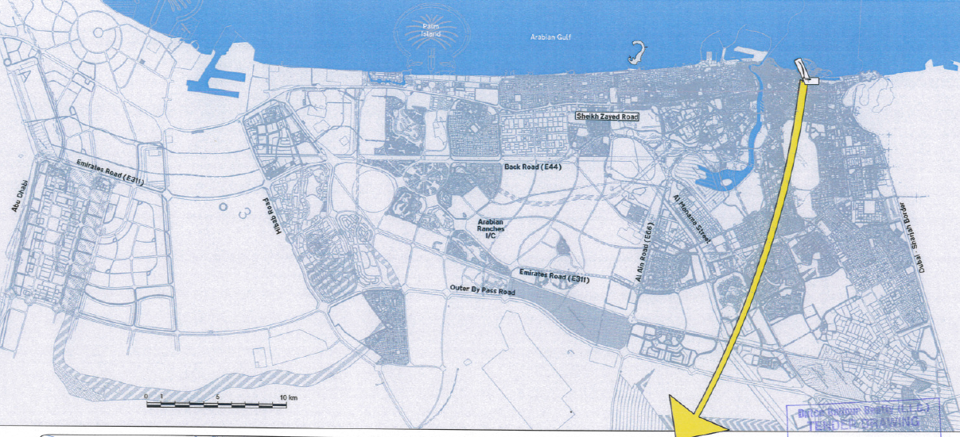
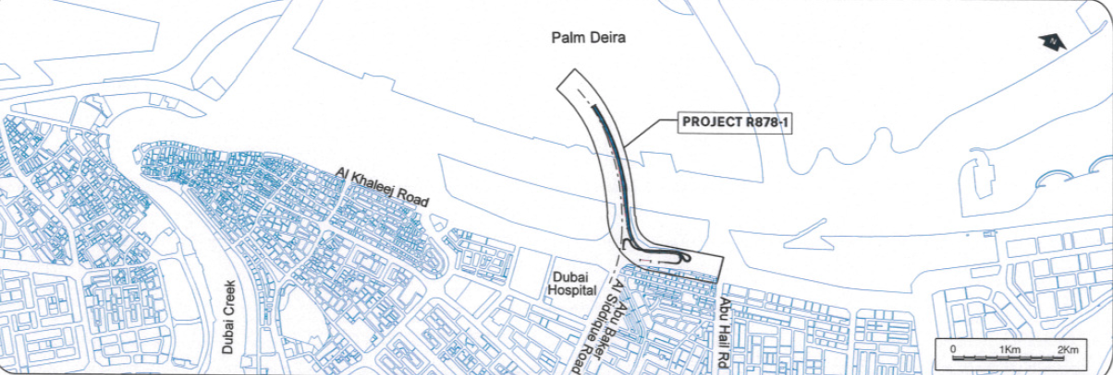
PROJECT LOCATION
Located at Extension of Abu Baker Al Siddique Road Crossing Dubai Creek and to Palm Deira.

Slide 3
SCOPE OF WORKS
UTILITIES
  Sewerage Line Protection = 40 m
  Drainage Pipeline Installation (Removal) = 866 m (175)
  DEWA Water Pipeline Installation (Removal) = 140 m (140)
  Irrigation Ductline Installation = 15 m
  Etisalat Duct Protection = 113 m
  DEWA LV Ductline Installation = 185 m
  DEWA HV Protection = 124 m
  Street Lighting Cabling / Poles = 4,822 m (60 nr)
ROADWORKS
  Wetmix = 2,317 T
  Asphalt (Base / Wearing) = 5,048 T (1,384 / 3,664)
  Kerbs = 3,686 m
  60mm Pavers = 316 m²
MARINE WORKS
  Excavation = 1,618,265 m³
  Disposal of Excavated Materials = 1,613,630 m³
  Underlayer Rock (5 – 40 kg) = 4,563 m³
  Armour Rock (60 – 300 kg) = 9,603 m³

Slide 4
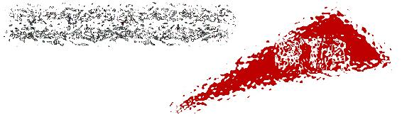

GENERAL INFORMATION
CLIENT
CONSULTANT

Slide 5
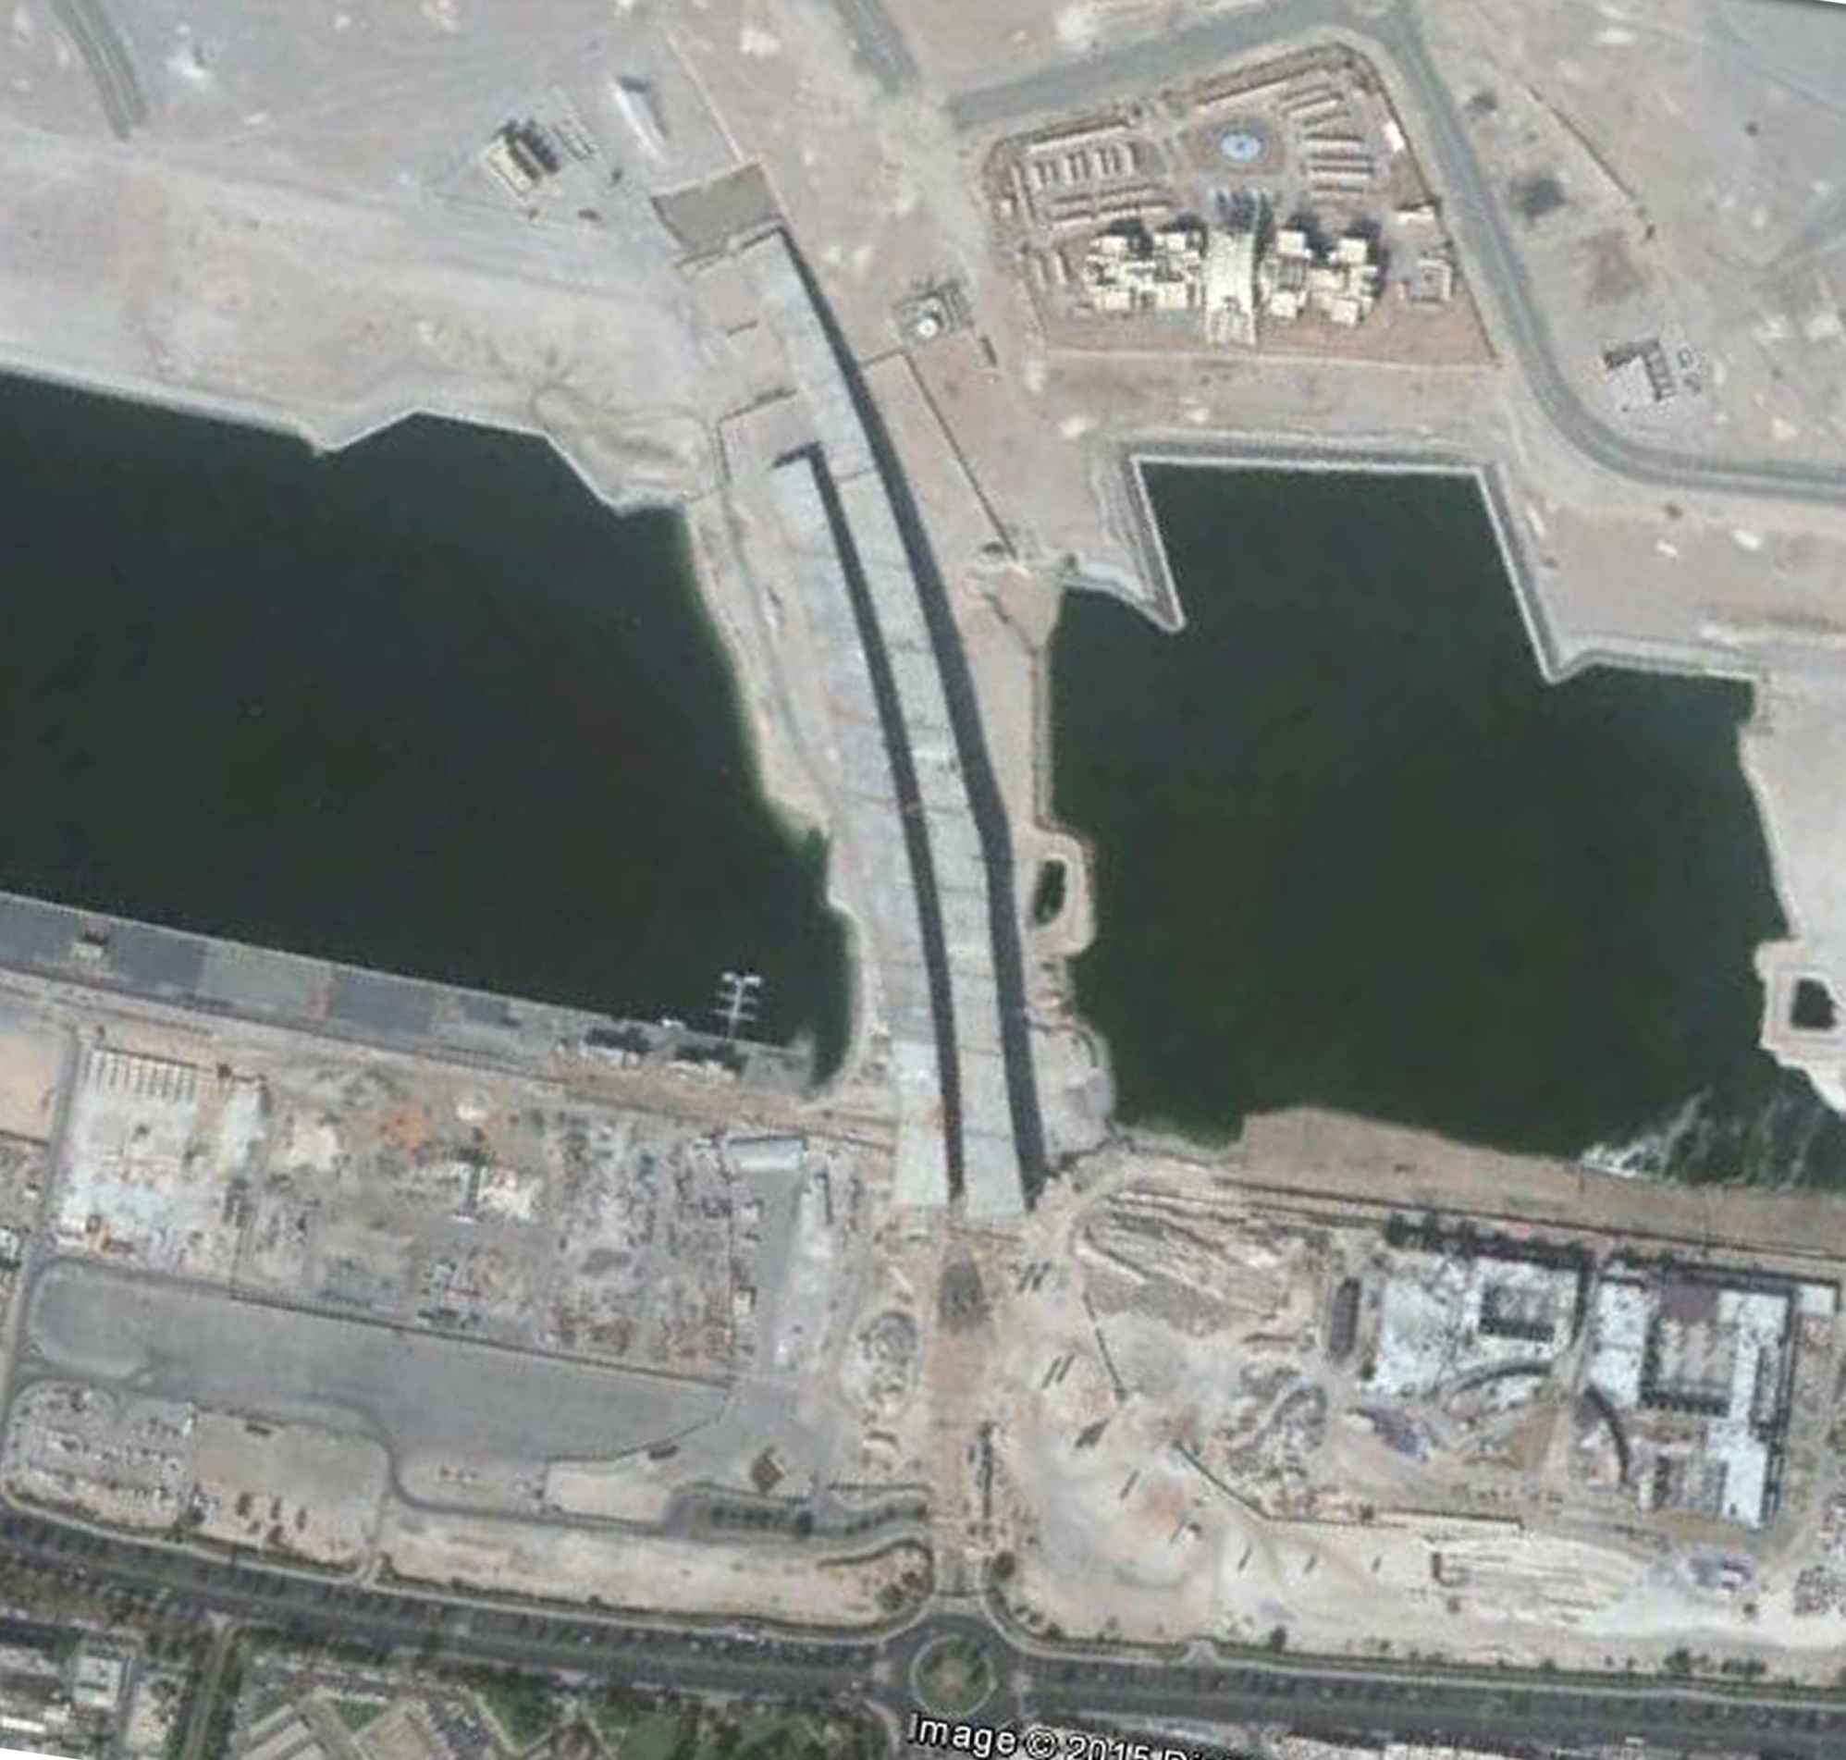
EXISTING CONDITION

Slide 6
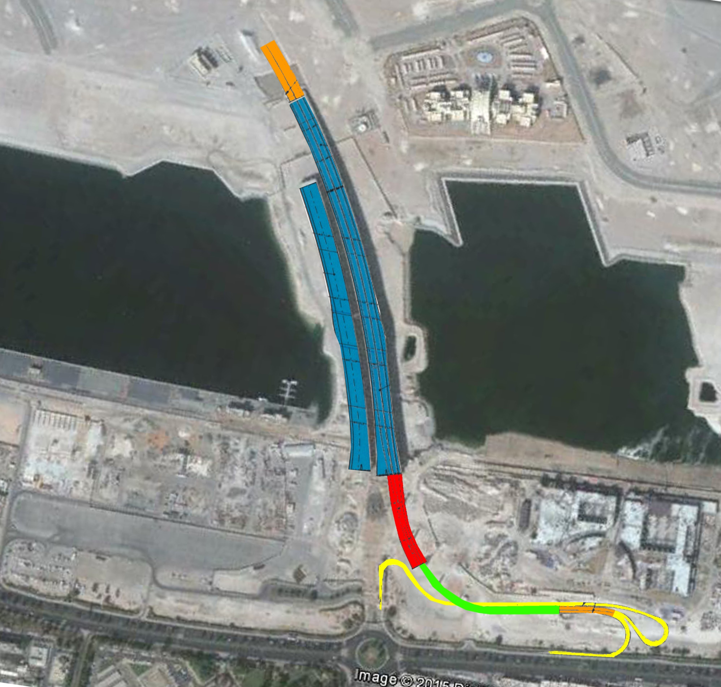
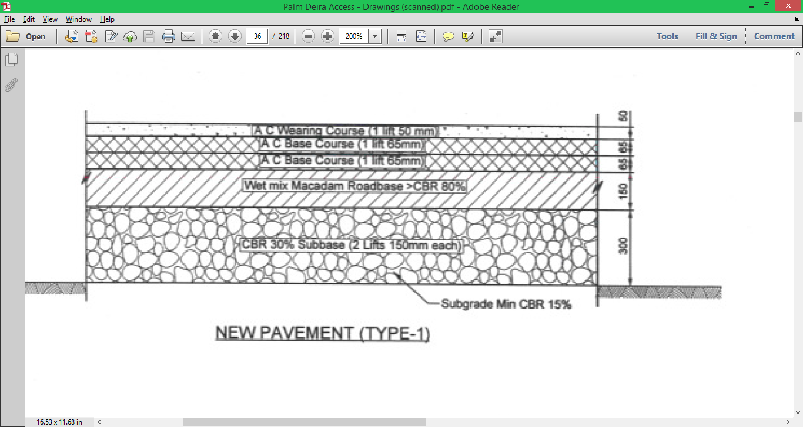
GENERAL LAYOUT (STRUCTURES)
Bridge Ramp
BRIDGE RAMP
EXISTING BRIDGES (designated Bridge 0)
680m & 510m long
31.5m wide
Coating and Deck Finishing Works
IN-L BRIDGE (Bridge 1)
166m long
About 24.4m wide
3 spans
Superstructure and Finishing Works (Piers already constructed)
IN-R BRIDGE (Bridge 2)
265m long
About 13.7m wide
6 spans
Superstructure and Finishing Works (Piers already constructed)
Roadworks
2 traffic lanes

Slide 7
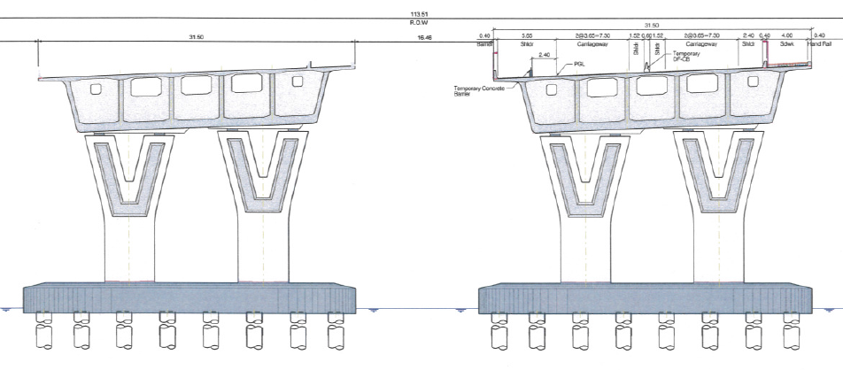
SECTIONS (EXISTING BRIDGES)

Slide 8
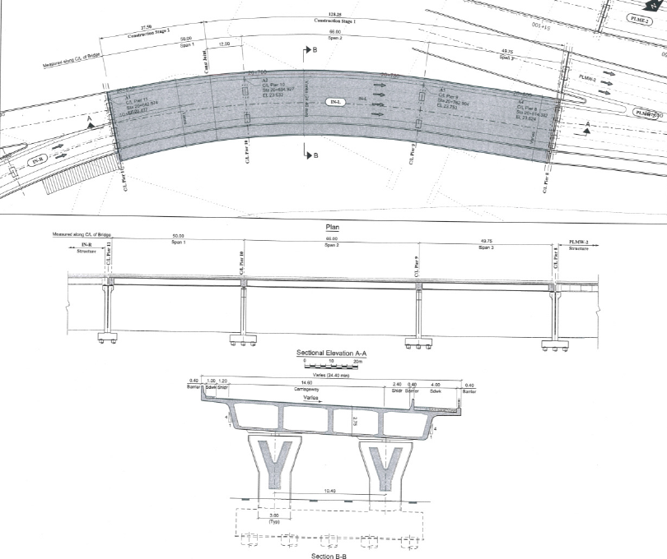
SECTIONS (BRIDGE 1)

Slide 9
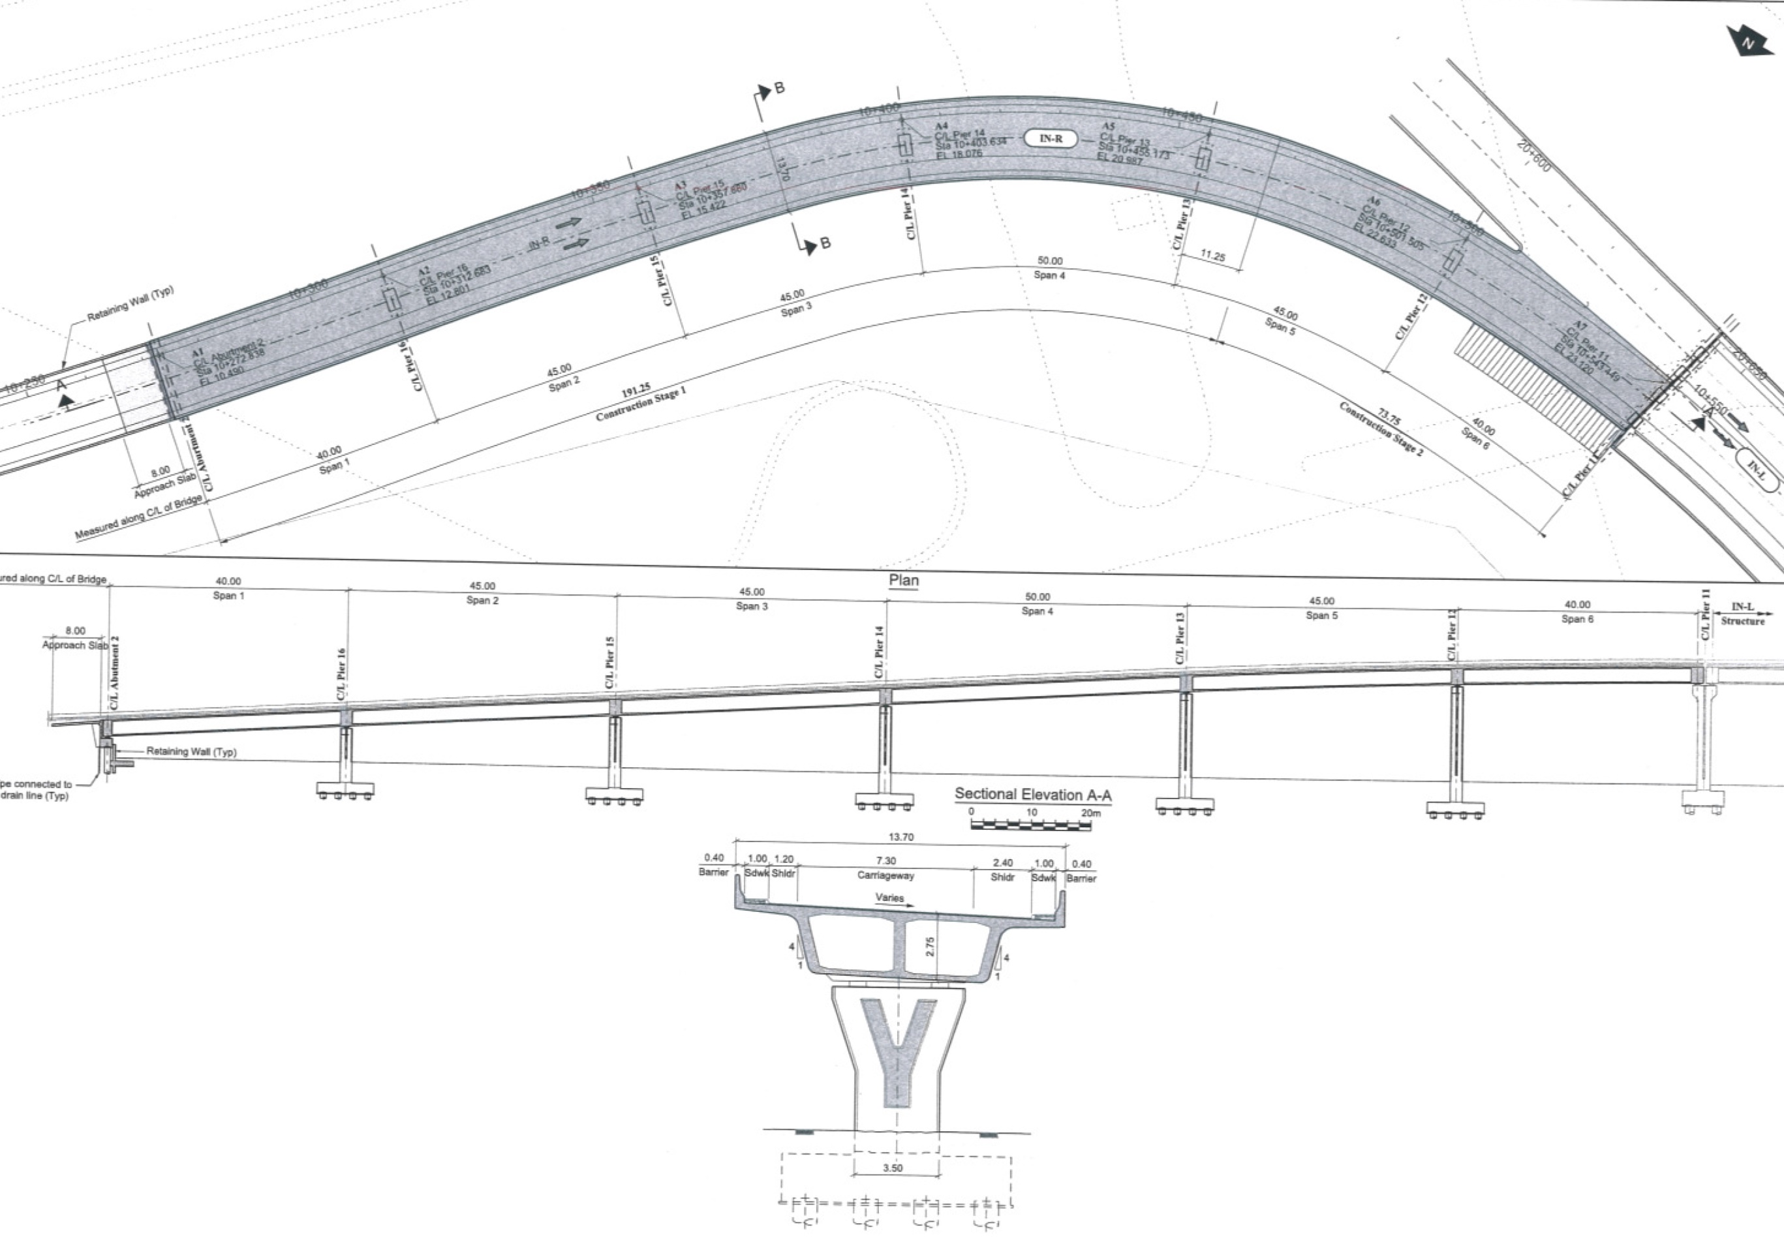
SECTIONS (BRIDGE 2)

Slide 10
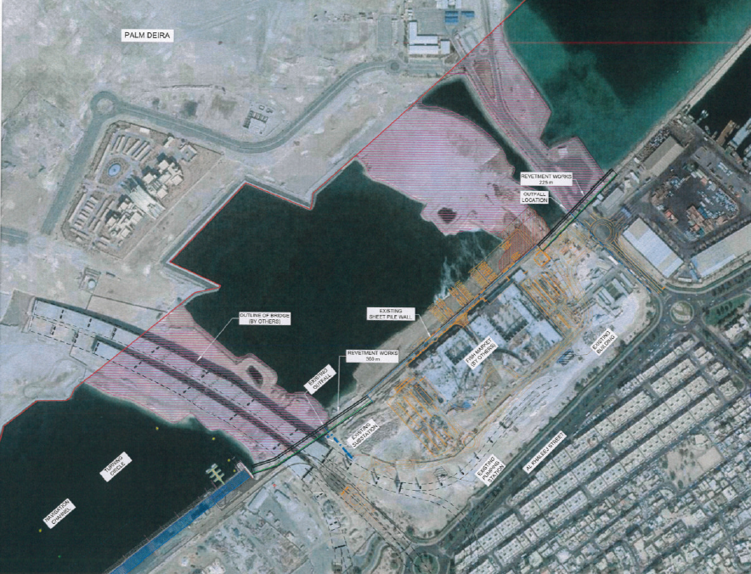
GENERAL LAYOUT (MARINE)

Slide 11
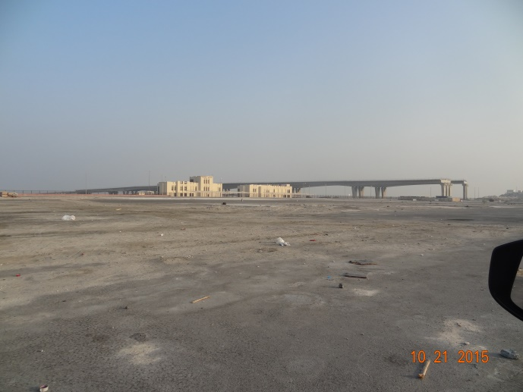
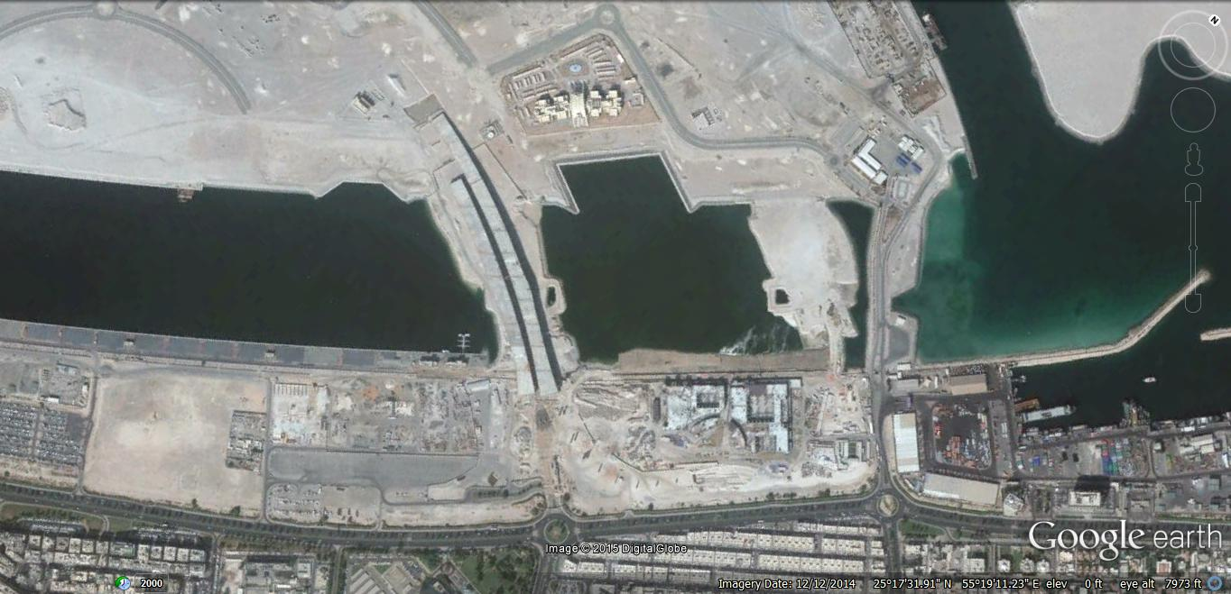
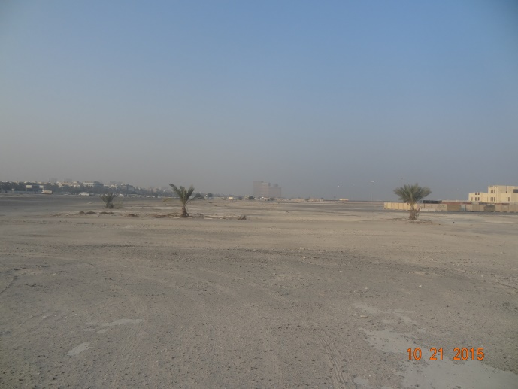
SITE PHOTOS
A
B
PHOTOS 01. Available Space for Site Set-up.

Slide 12
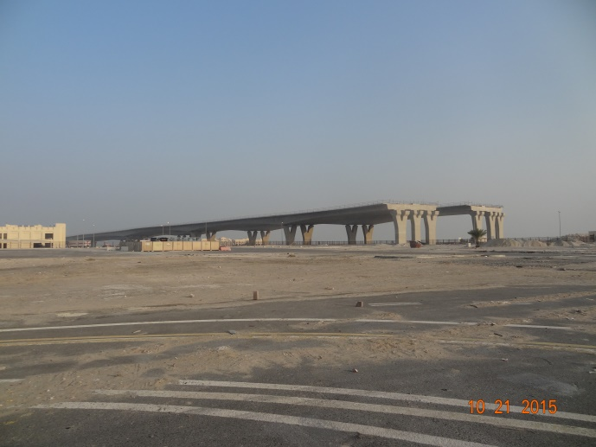
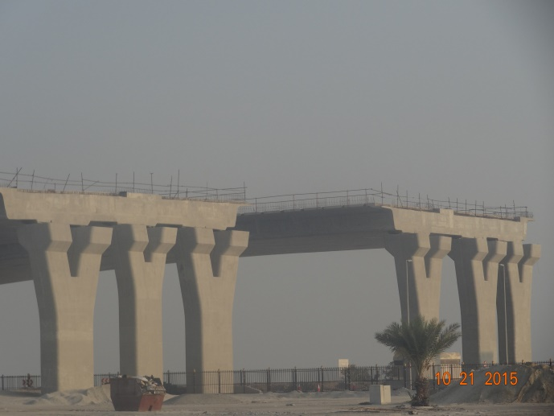
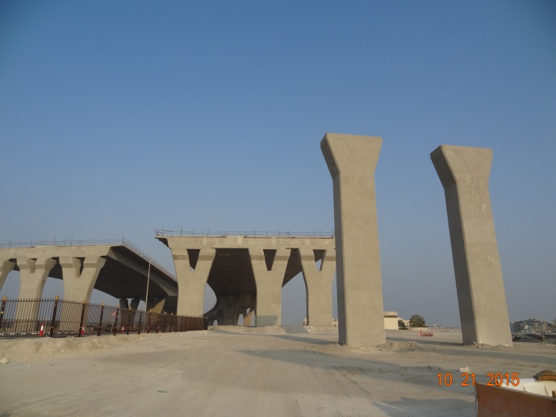
SITE PHOTOS
A
B
C
PHOTOS 02. Existing Bridges.

Slide 13
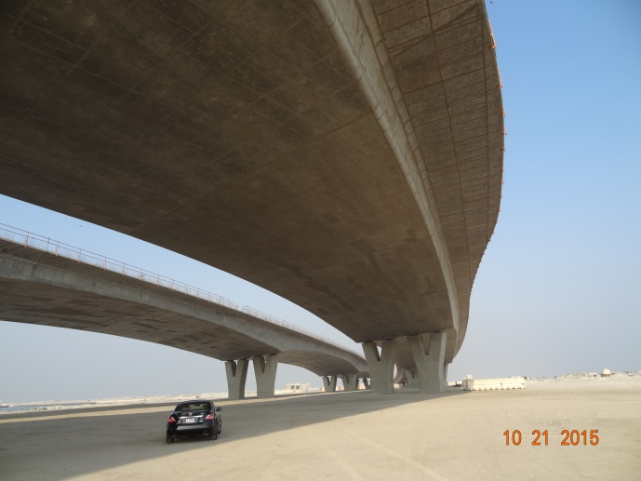
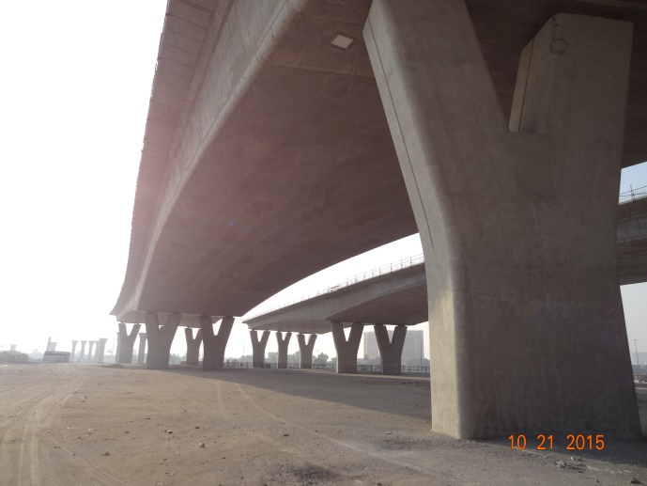
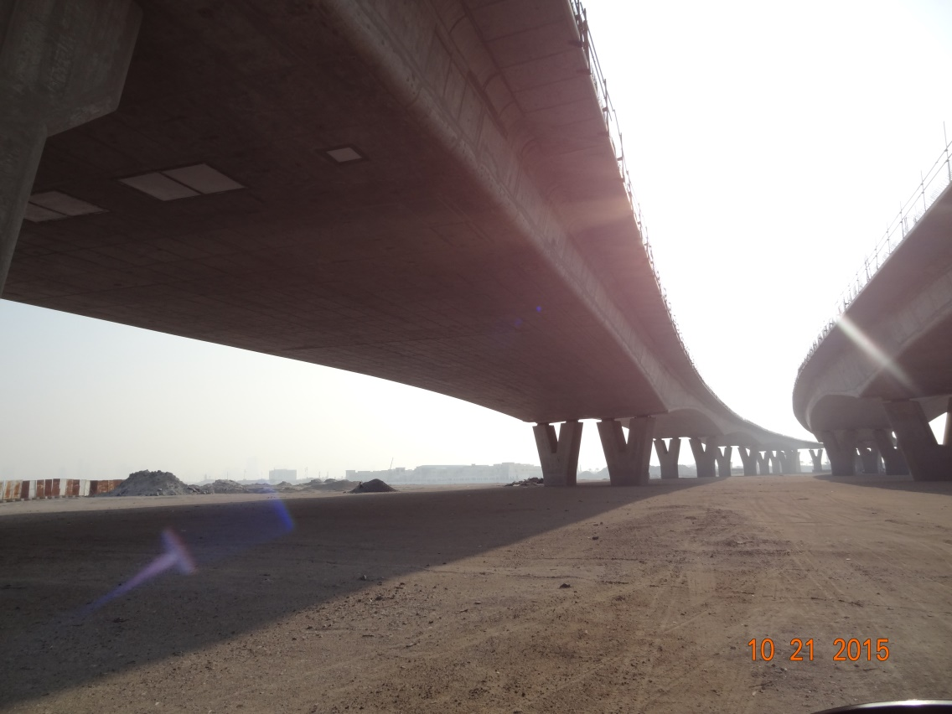
SITE PHOTOS
A
B
C
PHOTOS 03. Existing Bridges.

Slide 14
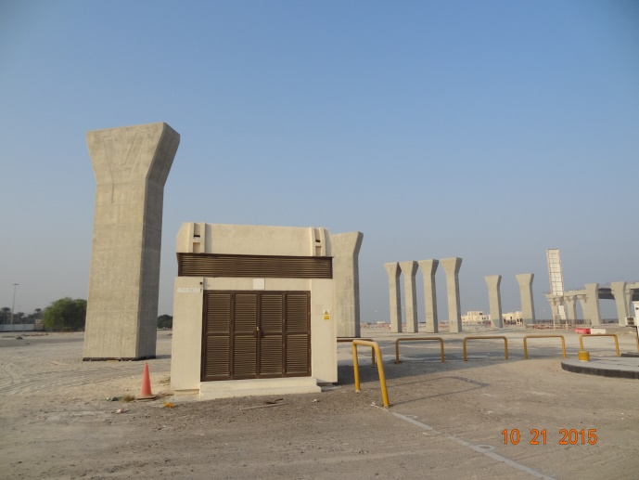
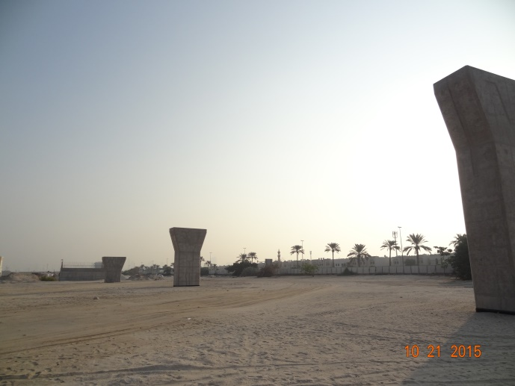
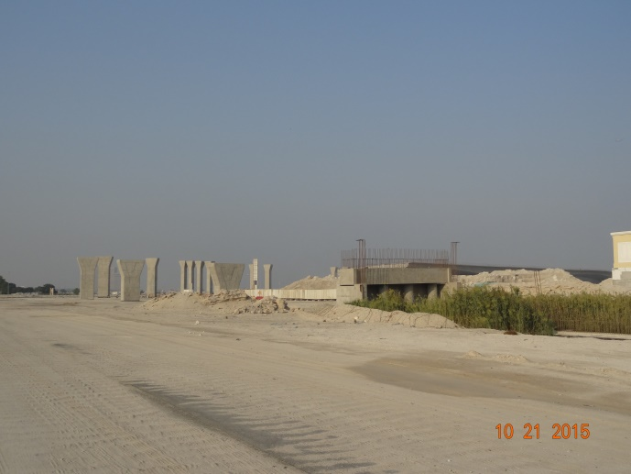
SITE PHOTOS
A
B
C
PHOTOS 04. Existing Bridges.

Slide 15
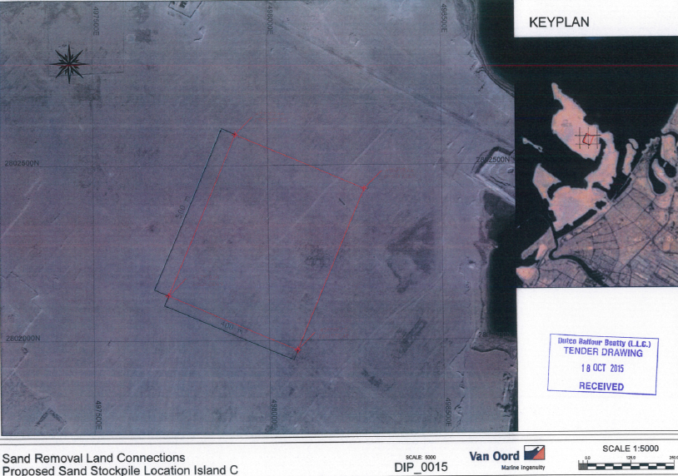
PROPOSED SAND STOCKPILE LOCATION
400 x 500 m = 20 ha
About 5.5 km from dredging location

Slide 16
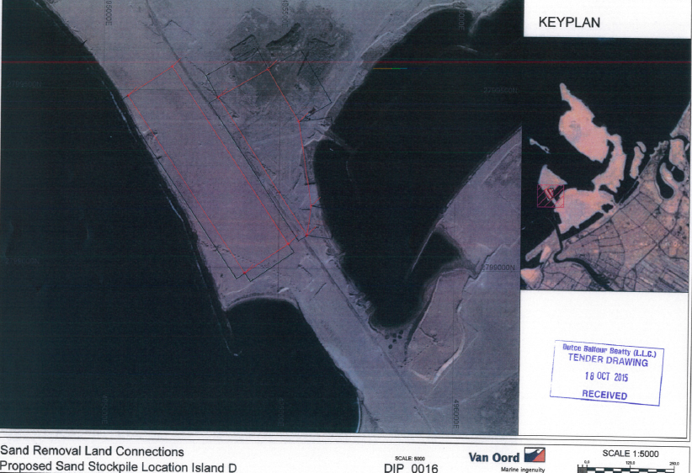
PROPOSED SAND STOCKPILE LOCATION
About 4 ha
About 3.6 km from dredging location
600 x 150 m = 9 ha
About 3.6 km from dredging location

Slide 17
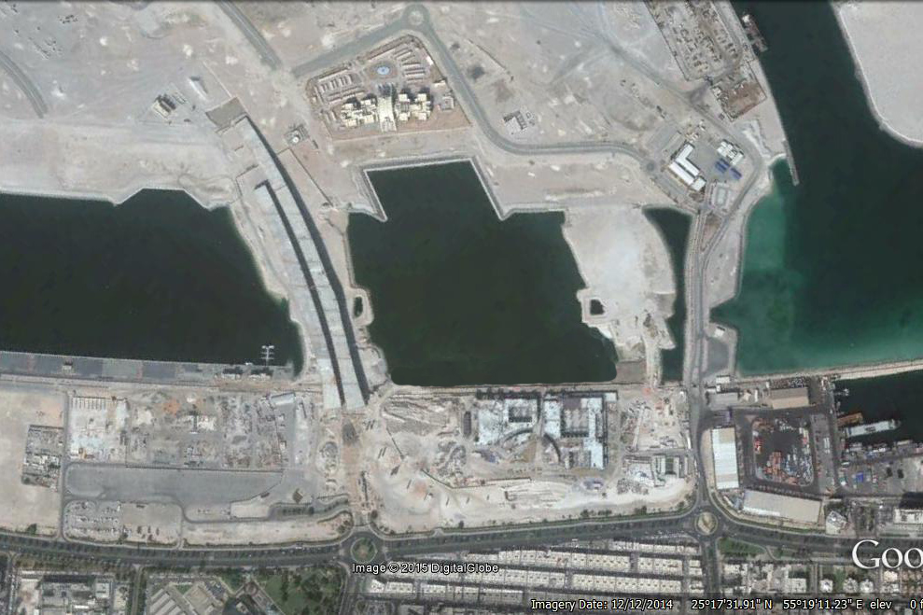
GENERAL WORK SEQUENCE (STAGE 0)

Slide 18
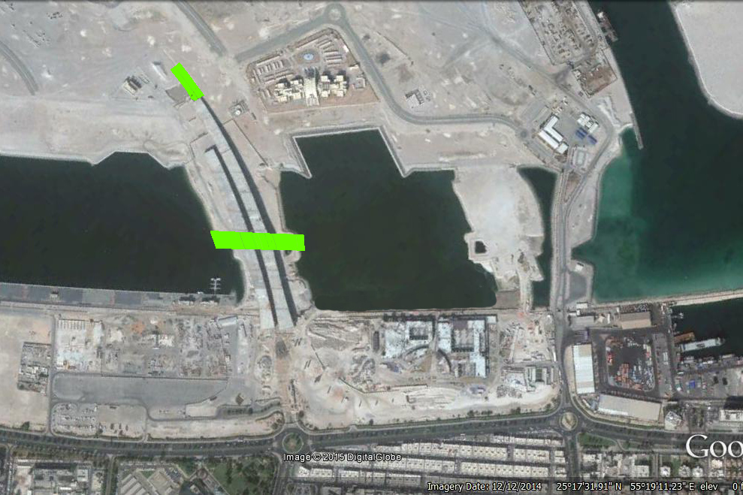
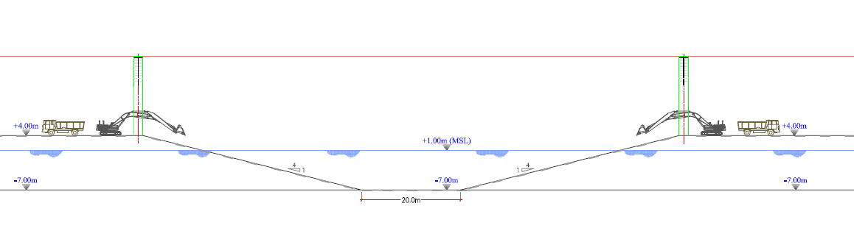
GENERAL WORK SEQUENCE (STAGE 1)
LEGEND:
In-Progress
Completed
Soil Wall 1 Construction
Excavation of Navigation Channel upto -7.0 DMD, 20m Clear Width

Slide 19
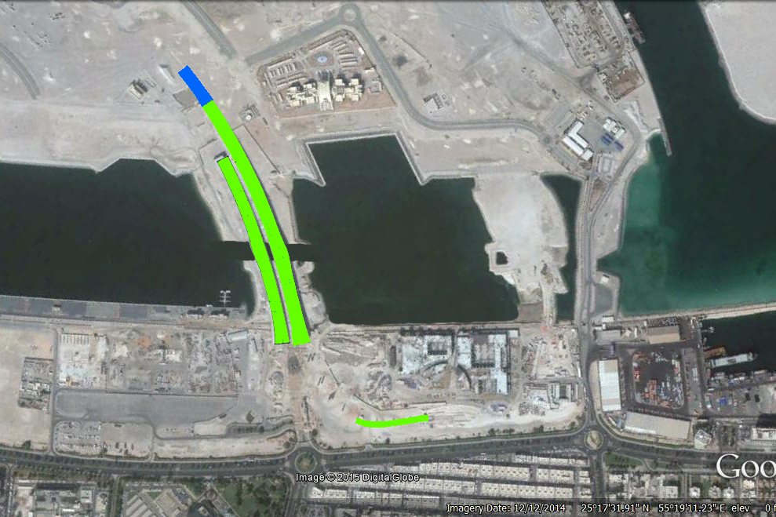
GENERAL WORK SEQUENCE (STAGE 2)
LEGEND:
In-Progress
Completed
Existing Bridges Finishing Works
4/6 Deck Construction of Bridge 2

Slide 20
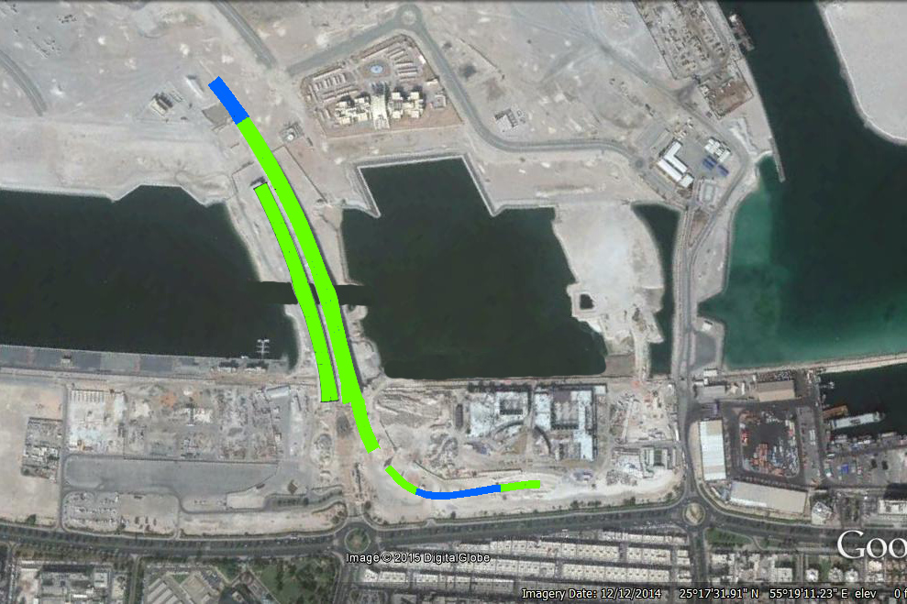
GENERAL WORK SEQUENCE (STAGE 3)
LEGEND:
In-Progress
Completed
Existing Bridges Finishing Works
2/3 Deck Construction of Bridge 1
Construction of Remaining 2 Decks of Bridge 2
Soil Wall 2 Construction

Slide 21
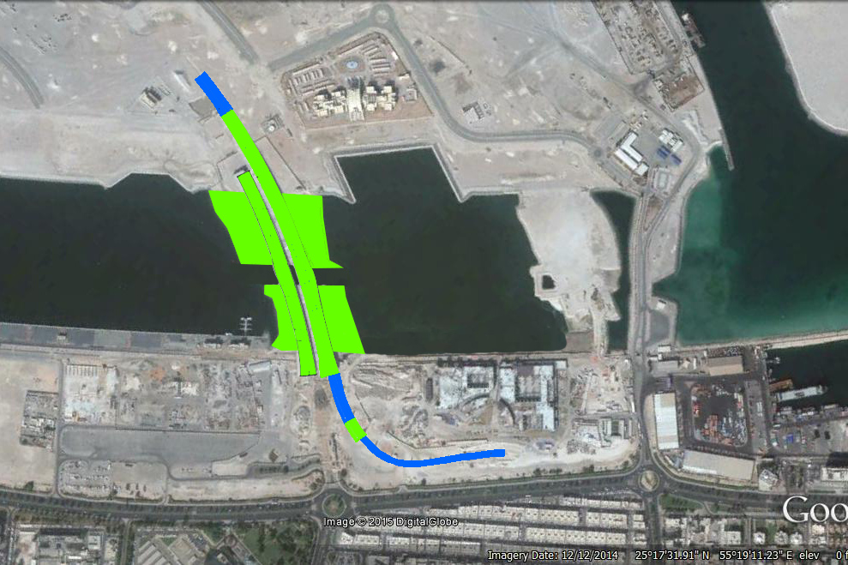
GENERAL WORK SEQUENCE (STAGE 4)
LEGEND:
In-Progress
Completed
Existing Bridges Finishing Works
Dyke 1 Dredging
Construction of Remaining 1 Deck of Bridge 1

Slide 22
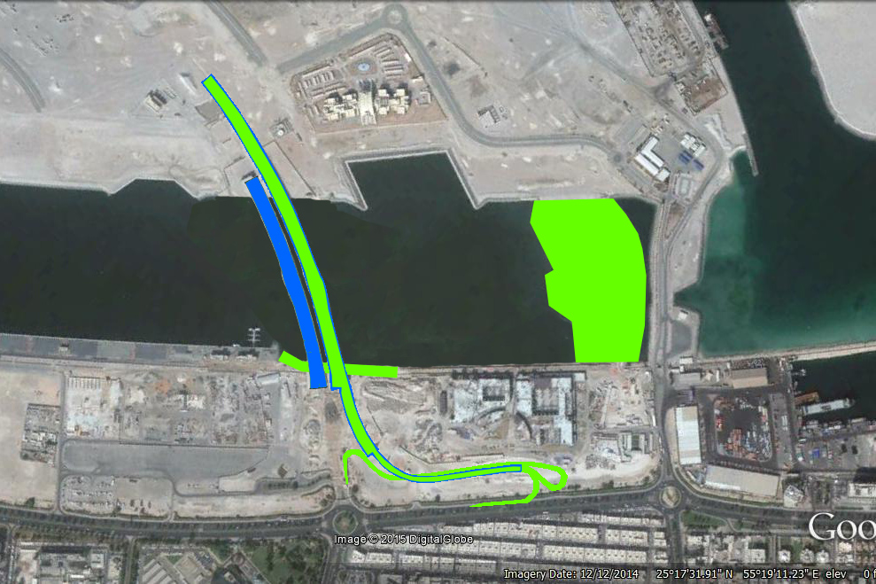
GENERAL WORK SEQUENCE (STAGE 5)
LEGEND:
In-Progress
Completed
Asphalting of Bridges
Dyke 2 Dredging
Revetment 1 Construction
Roadworks

Slide 23
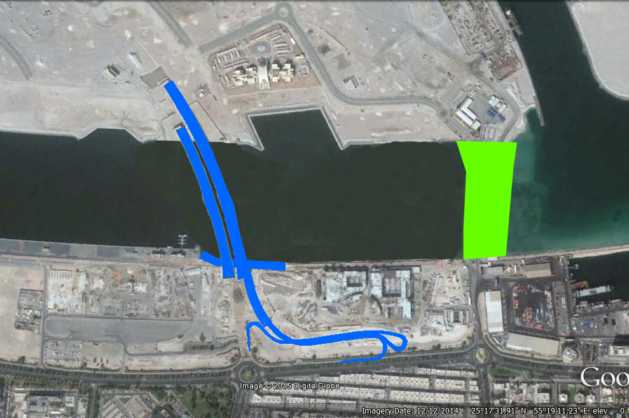
GENERAL WORK SEQUENCE (STAGE 6)
LEGEND:
In-Progress
Completed
Dyke 3 Dredging

Slide 24
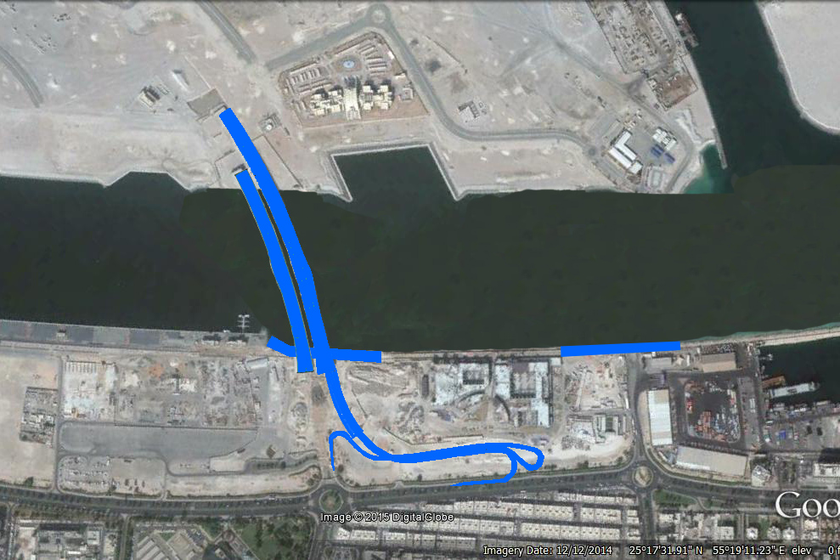
GENERAL WORK SEQUENCE (STAGE 7)
LEGEND:
In-Progress
Completed
Completion of Revetment 2

Slide 25
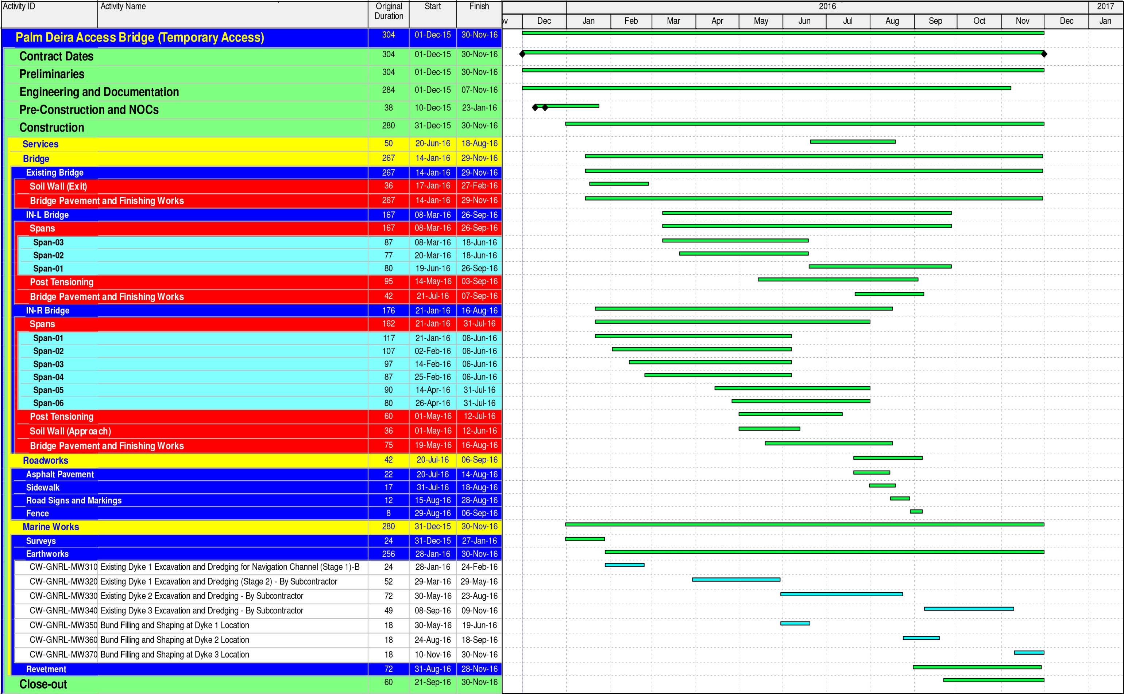
TENDER PROGRAMME

Slide 26
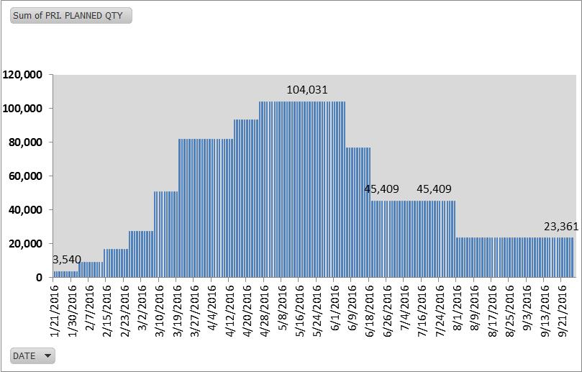
BRIDGE SCAFFOLDINGS
TOTAL VOLUME
127,424 m³
UTILIZATION
1,859,953 m³.wk
PEAK RQM’TS
104,031 m³

Slide 27
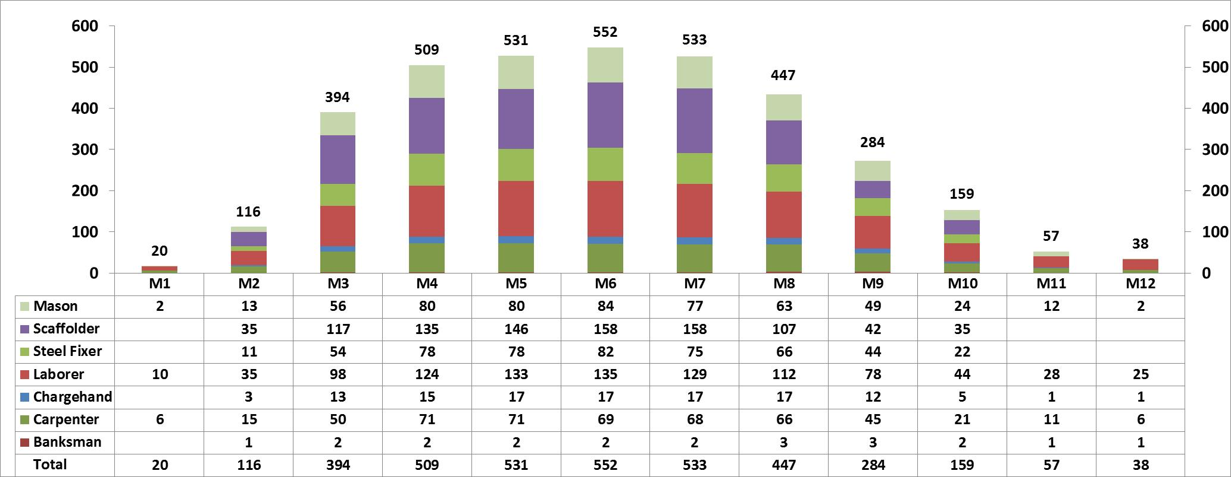
PROPOSED DIRECT LABOR
* Includes only direct and site support manpower (subcontractors’ excluded).
** To be consolidated with Estimating Team.

Slide 28
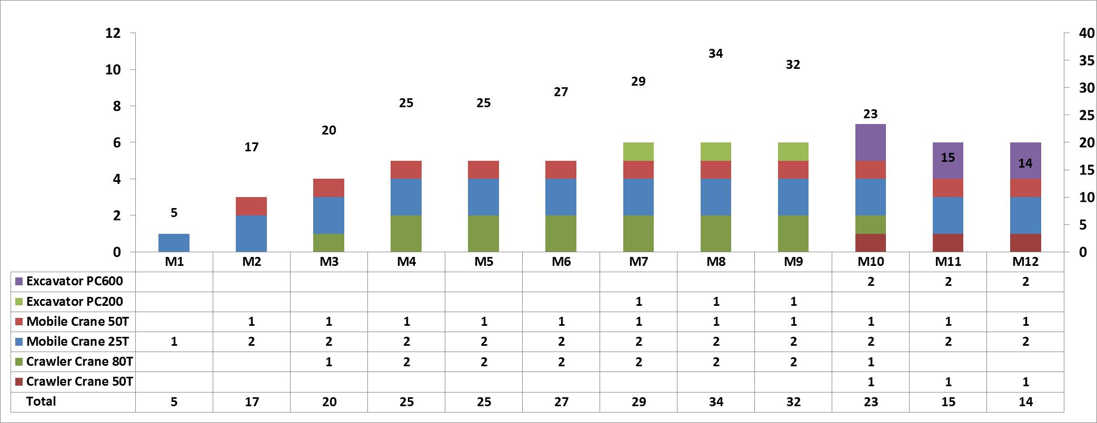
PROPOSED PLANT
* Includes only direct and site support manpower (subcontractors’ excluded).
** To be consolidated with Estimating Team.
*** Shown in the histogram are major plants only.

